Slide 1
Object Detection & Tracking in Point Clouds
Chaoda Zheng
2020.6.13

Slide 2
Paper list
3D-MPA: Multi Proposal Aggregation for 3D Semantic Instance Segmentation(CVPR 2020)
MLCVNet: Multi-Level Context VoteNet for 3D Object Detection(CVPR 2020)
P2B: Point-to-Box Network for 3D Object Tracking in Point Clouds (CVPR 2020 oral)

Slide 3
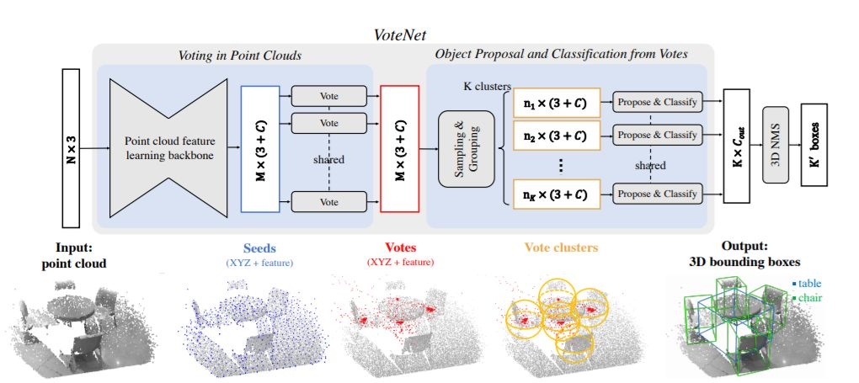
Preliminary

Slide 4
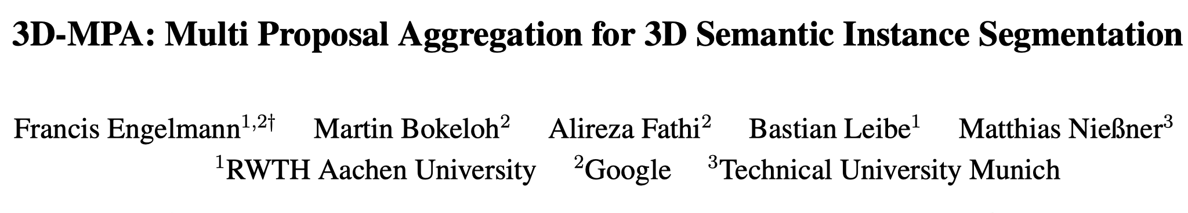

Slide 5
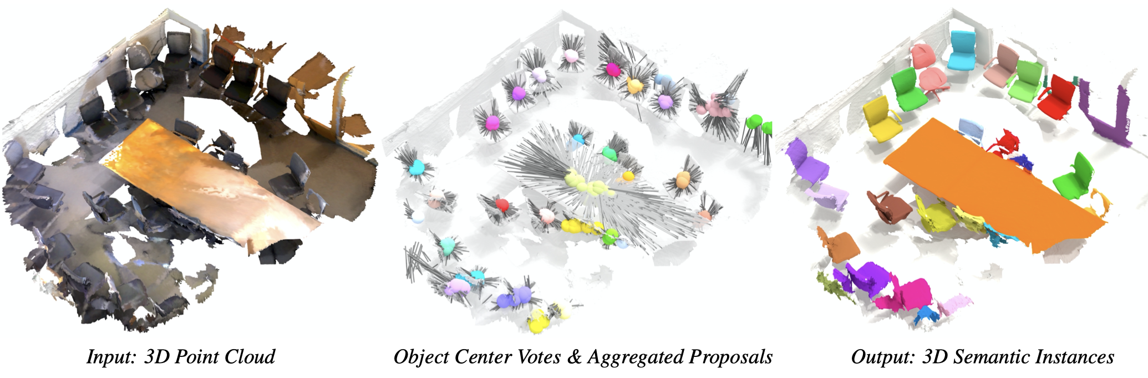
3D Semantic Instance Segmentation

Slide 6
How to predict and process object proposals?
Top-Down
ﬁrst predict a large number of rough object bounding box proposals followed by a second stage refinement step.
Bottom-Up
utilize metric-learning methods with the goal of learning a per-point feature embedding space which is subsequently clustered into object instances

Slide 7
How to predict and process object proposals?
Top-Down
😁 results can be generated in a single forward pass
☹️ little outlier tolerance to wrongly detected box anchors.
Bottom-Up
😁 can effectively handle outliers,
☹️ heavily depends on manually tuning cluster parameters
☹️ inherently expensive to compute at inference time O(N^2)

Slide 8
3D-MPA: a hybrid approach
Top-Down
😁 results can be generated in a single forward pass
☹️ little outlier tolerance to wrongly detected box anchors.
Bottom-Up
😁 can effectively handle outliers,
☹️ heavily depends on manually tuning cluster parameters
☹️ inherently expensive to compute at inference time O(N^2)

Slide 9
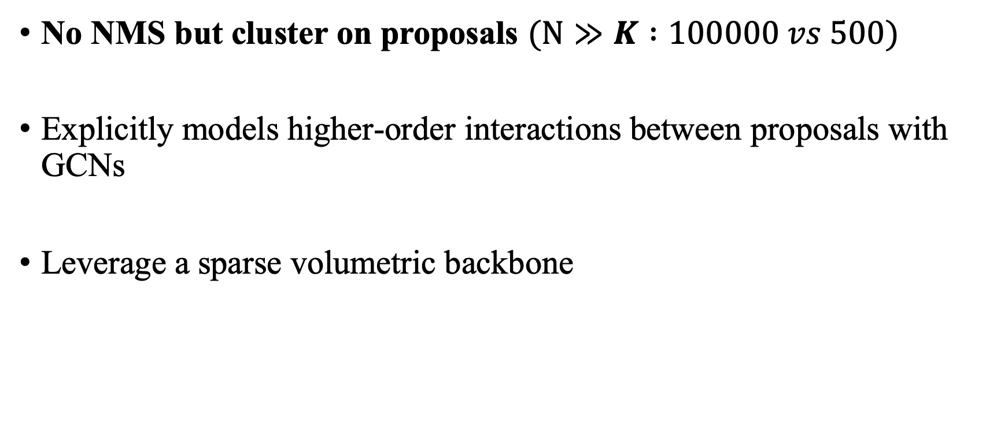
3D-MPA: a hybrid approach
No NMS but cluster on proposals $(N≫K :100000 vs 500)$
Explicitly models higher-order interactions between proposals with GCNs
Leverage a sparse volumetric backbone

Slide 10
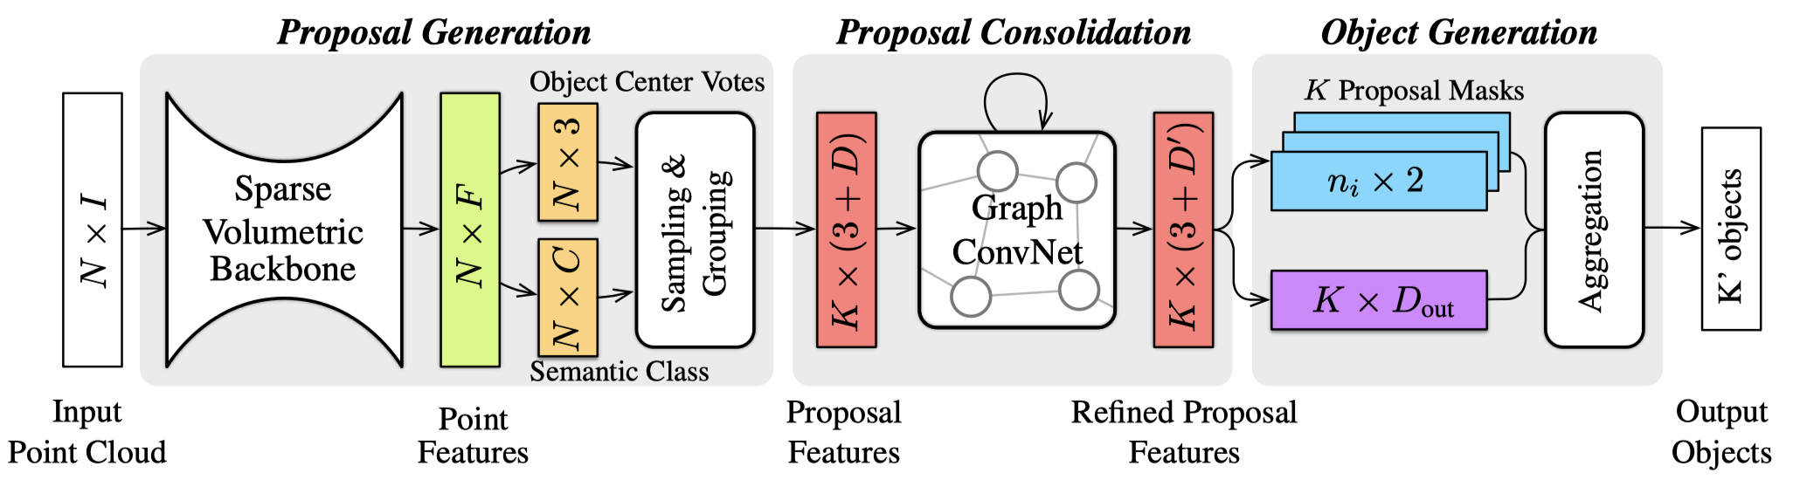
Architecture

Slide 11
Architecture
VoteNet

Slide 12
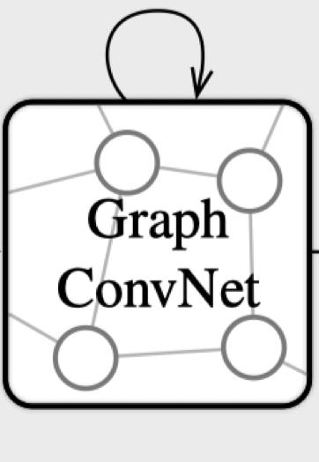

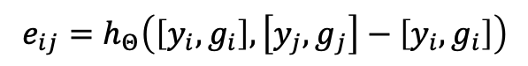
Proposal Consolidation
operates at the level of proposals.
explicitly modeling higher-order interactions between neighboring proposals.
proposals become aware of their global neighborhood
$$e_{ij}=h_{Θ}\left(\left[y_{i},g_{i}\right],\left[y_{j},g_{j}\right]−\left[y_{i},g_{i}\right]\right)$$
$$v_{i}=\left[y_{i},g_{i}\right]$$

Slide 13
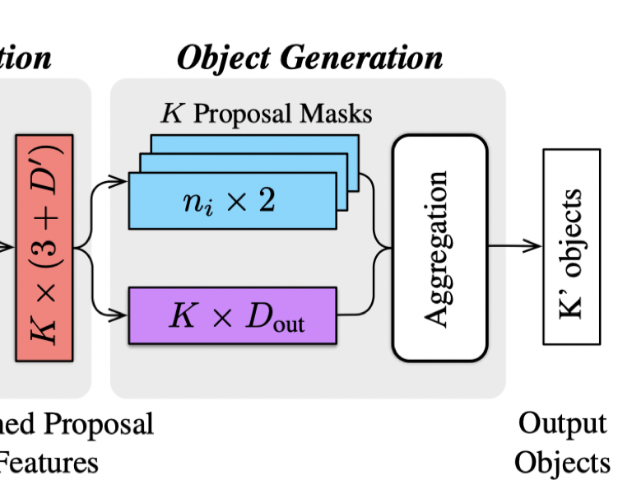
Object Generation

Slide 14
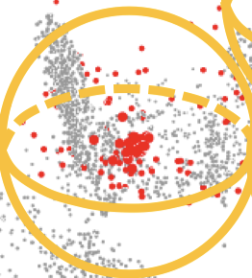

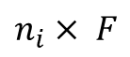
Object Generation
$$n_{i}× F$$
Segmentation PointNet

Slide 15
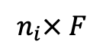
Object Generation
$$n_{i}× F$$
Segmentation PointNet
D_out = S + E + 2

Slide 16
Proposal Aggregation
NMS: rejecting proposals
Sensitive to the quality of the objectness scores and can discard correct predictions
MPA: combine multiple proposals
Cluster (DBScan) on aggregation features

Slide 17
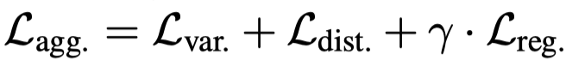
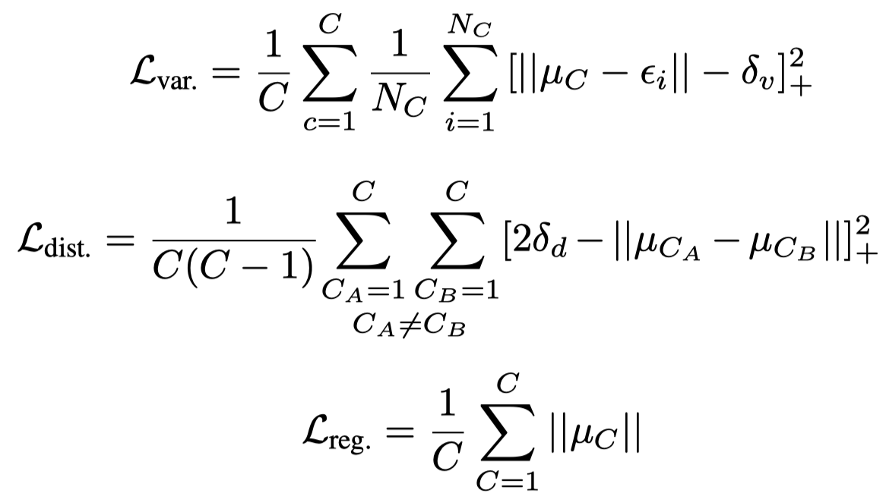
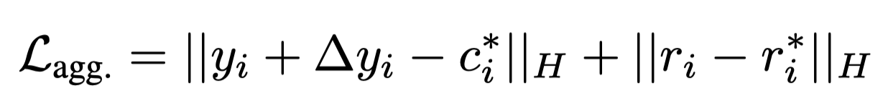
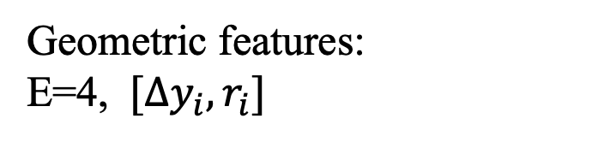
Aggregation Features
Geometric features:
E=4, $[Δy_{i}, r_{i}]$
Embedding features:
Pulls towards means
Push apart

Slide 18
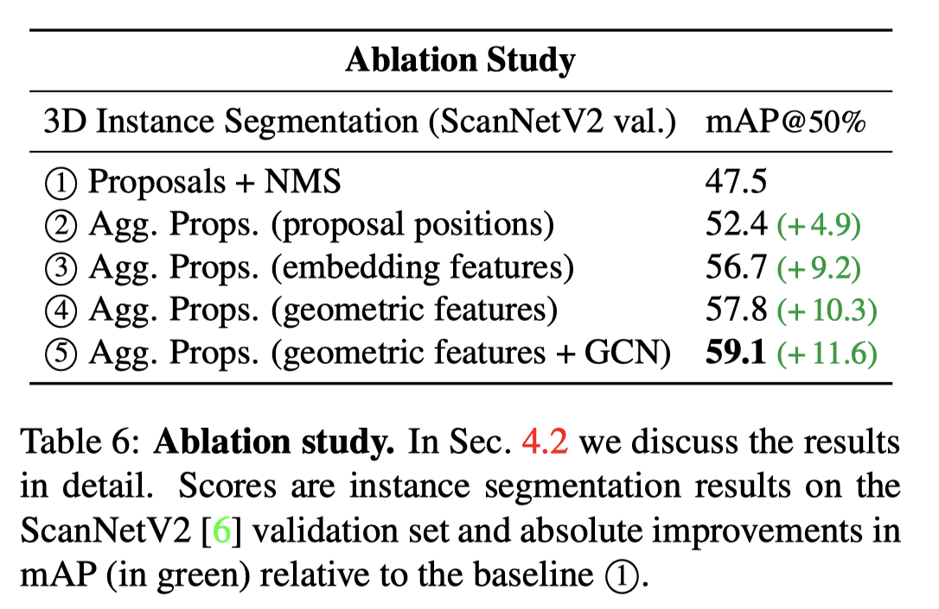
Ablation Study

Slide 19
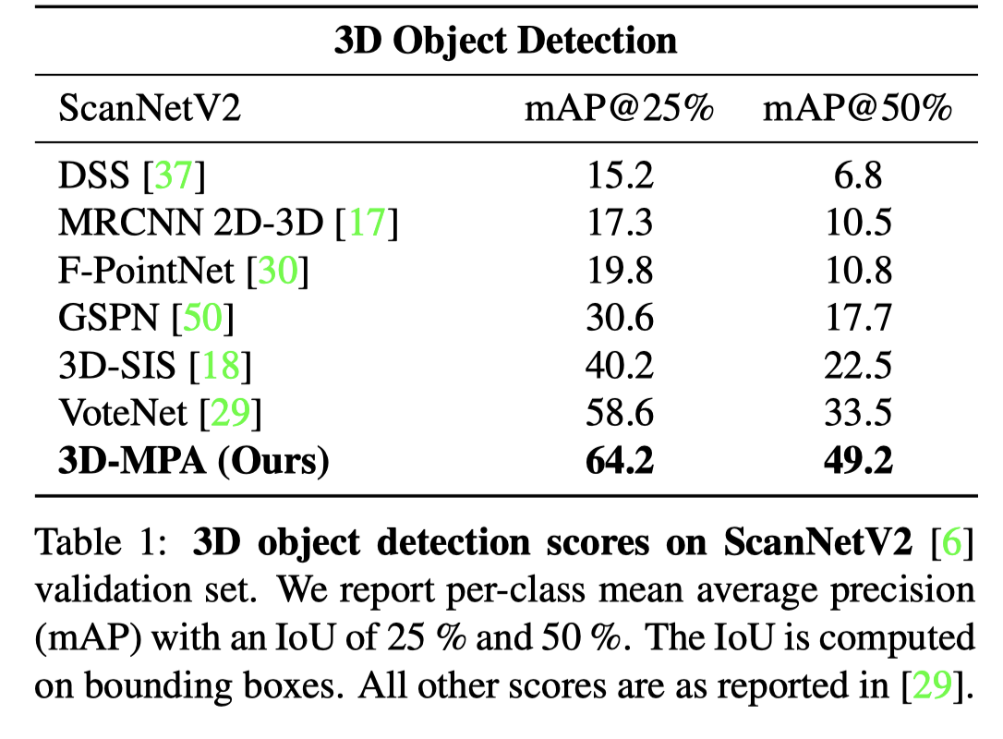
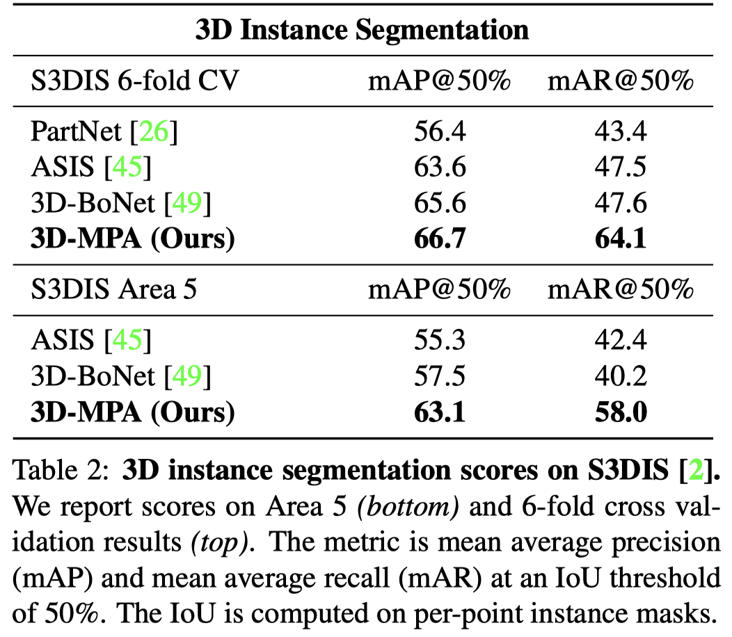
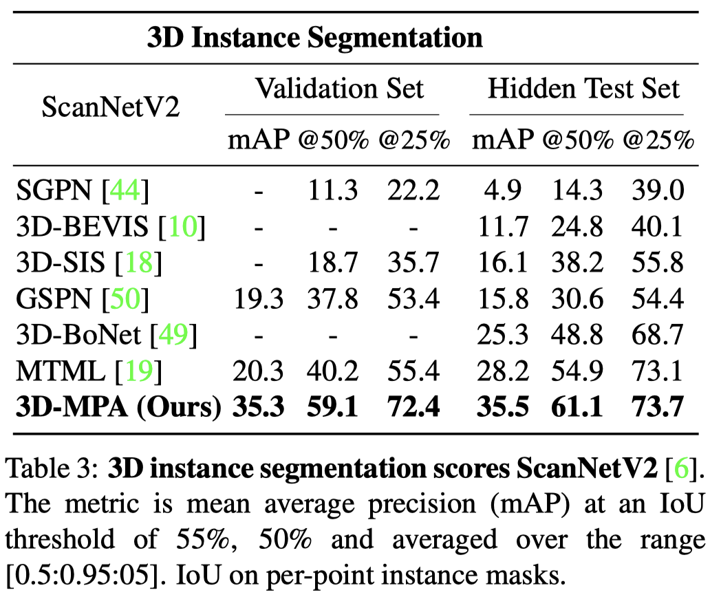
Comparison

Slide 20
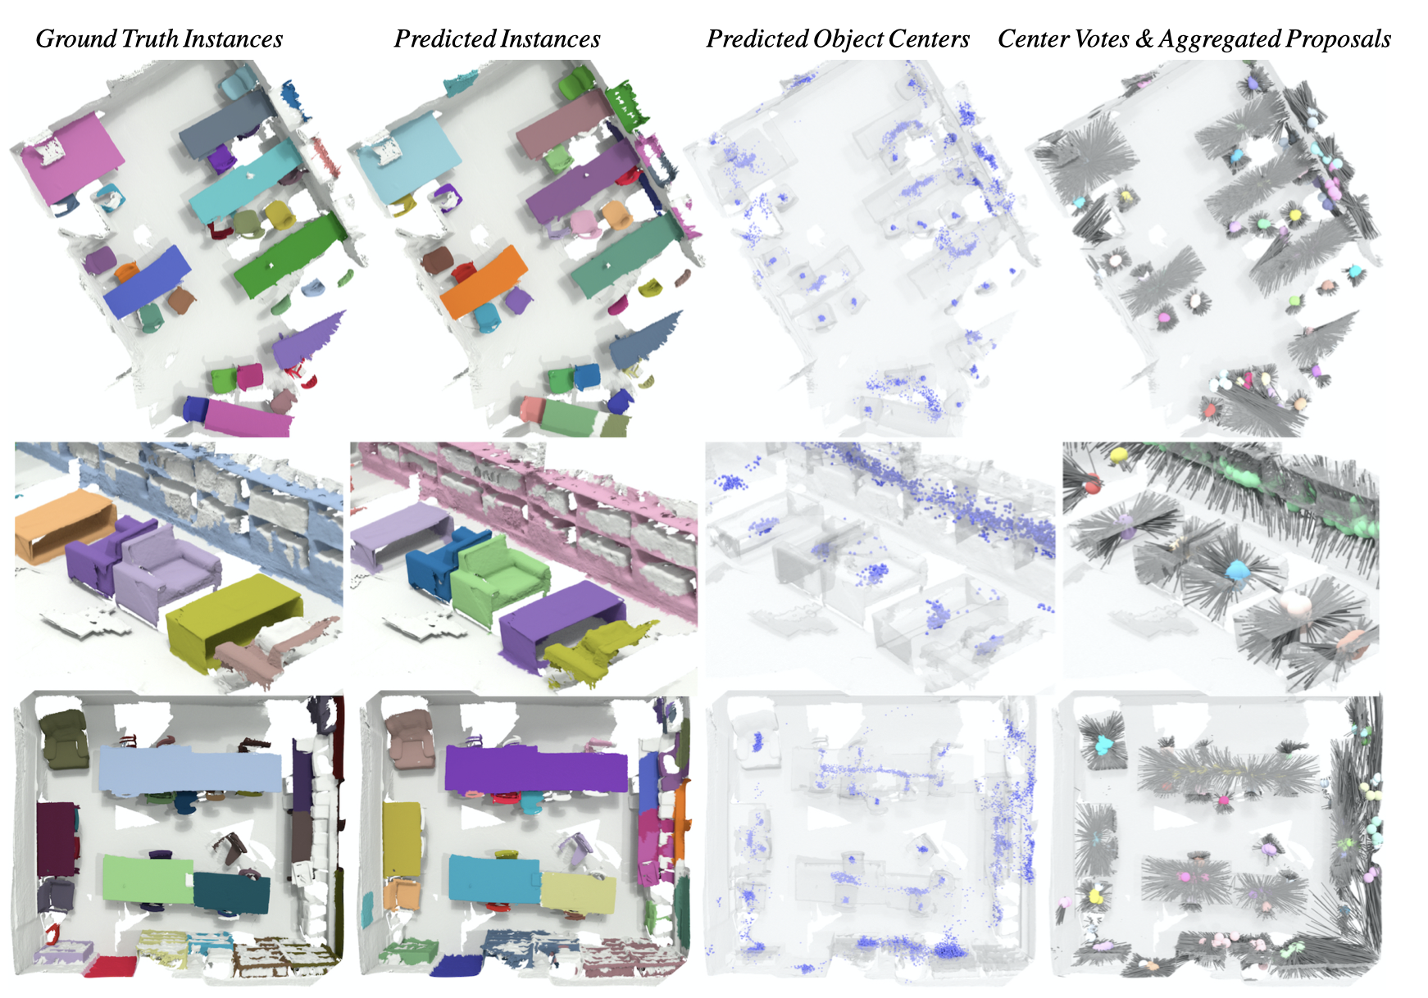
Visualizations

Slide 21
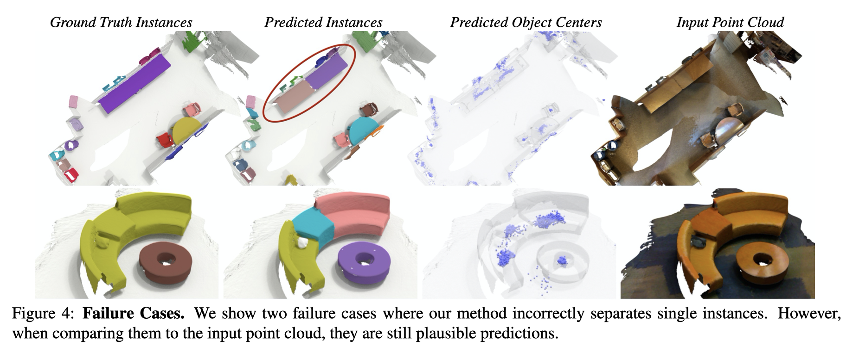
Visualizations

Slide 22
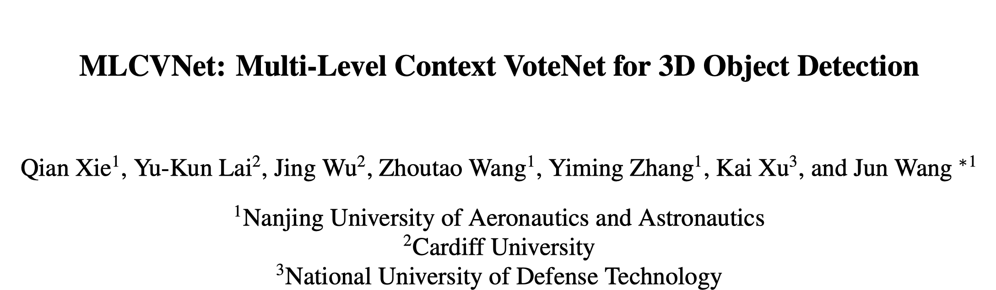

Slide 23
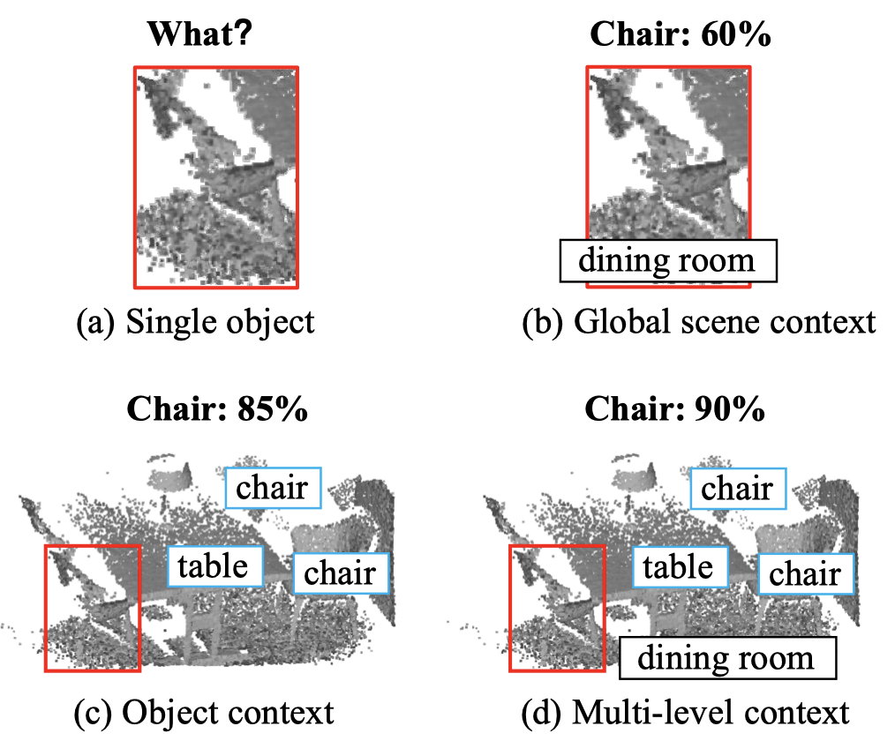
The insight
Multi-level contextual information is important for
3D object detection

Slide 24
Multi-level contextual information
Patch-patch context (object parts etc.)
Object-object context
Global-scene context

Slide 25
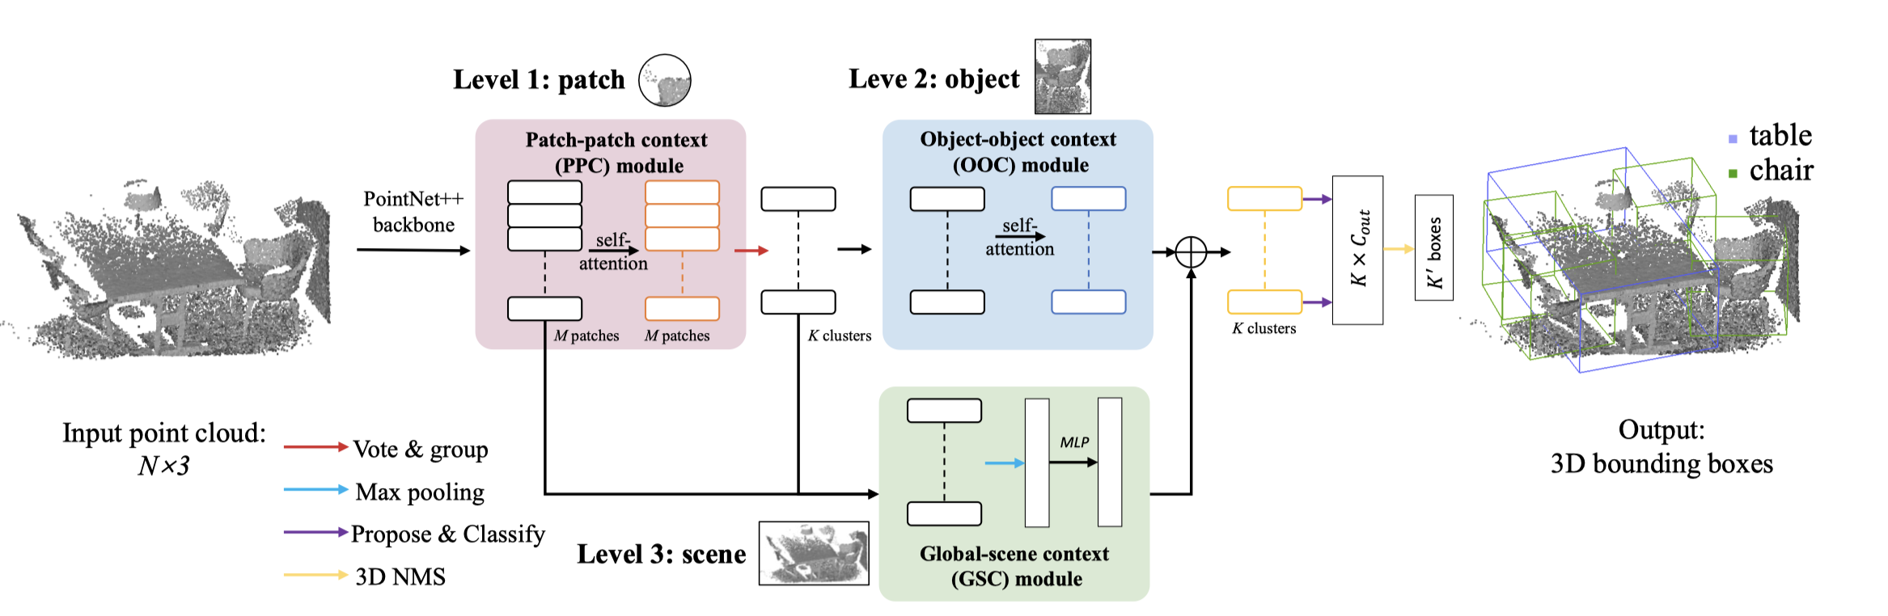
Architecture
VoteNet + self attention

Slide 26
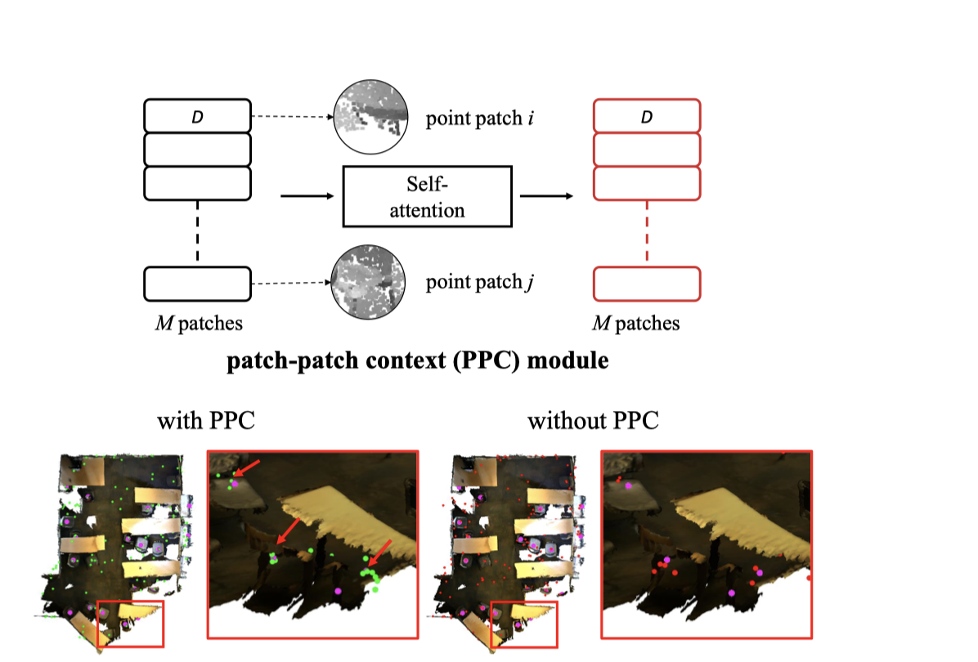
PPC Module
Enhance the performance of voting for object centers

Slide 27
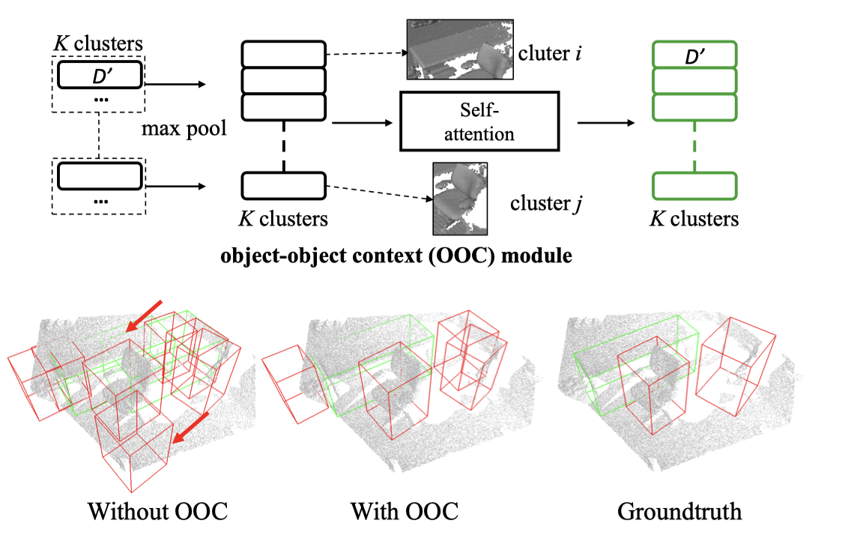
OOC Module
Fewer detected objects overlapping with each other, more accurate bboxes.

Slide 28
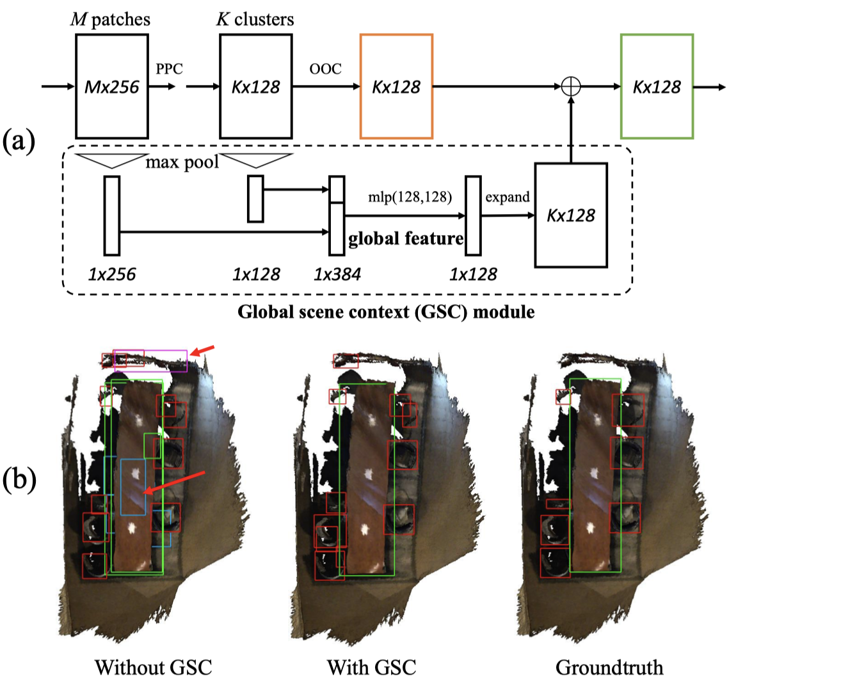
GSC Module
The ﬁnal prediction is more reliable under the effect of global cues

Slide 29
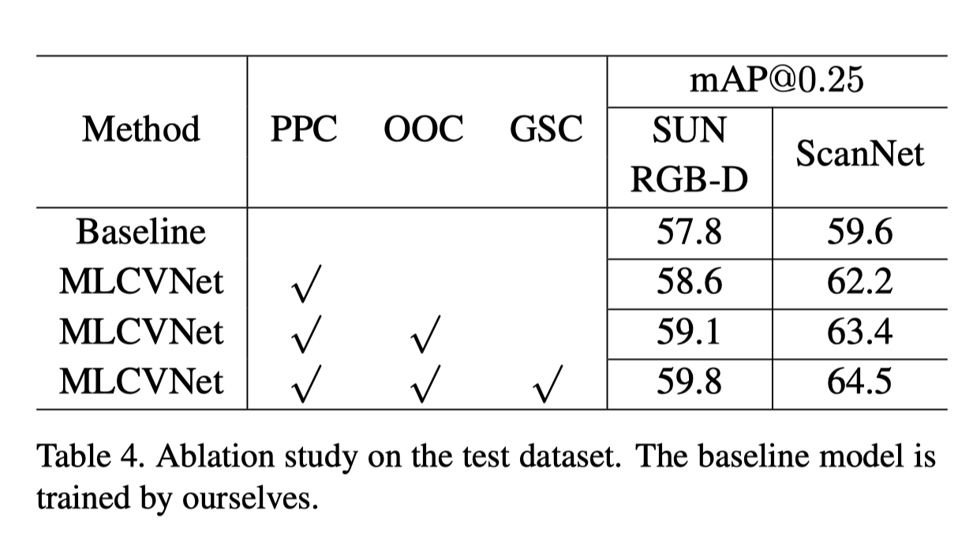
Ablation Study

Slide 30
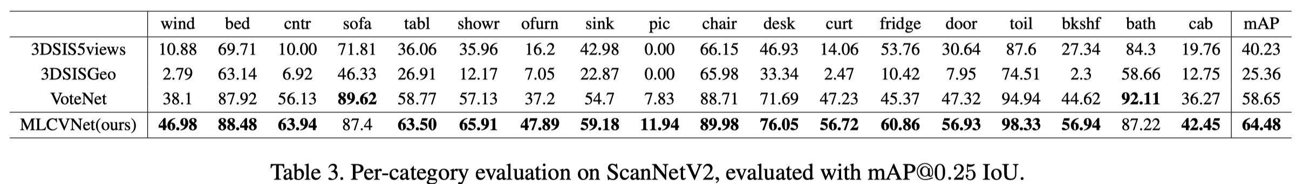
Comparison

Slide 31
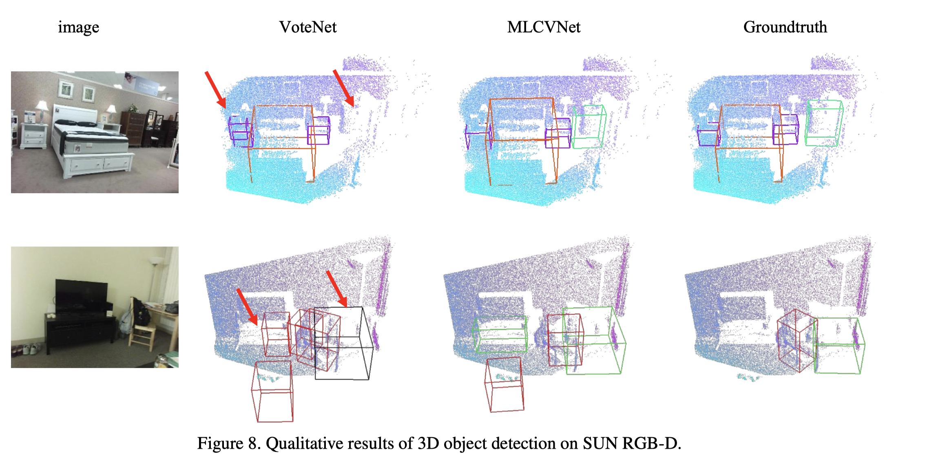
Comparison

Slide 32
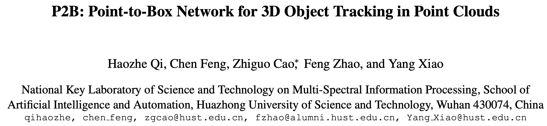

Slide 33
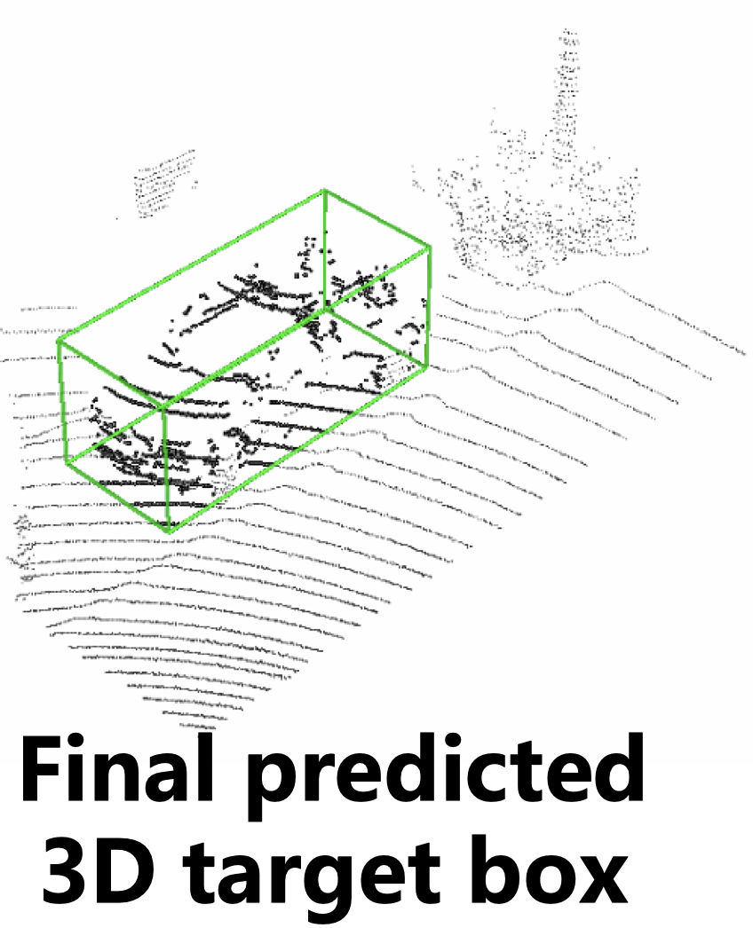
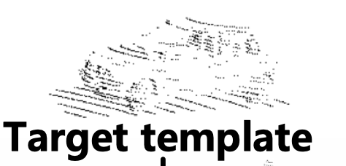
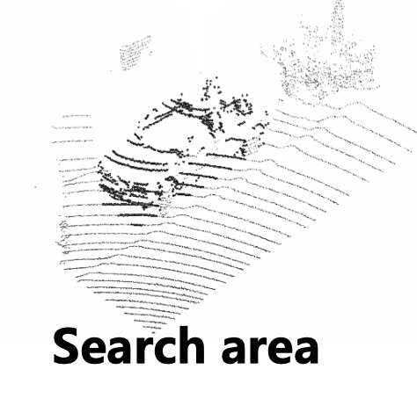
Object Tracking
Frame-by-frame in time order

Slide 34
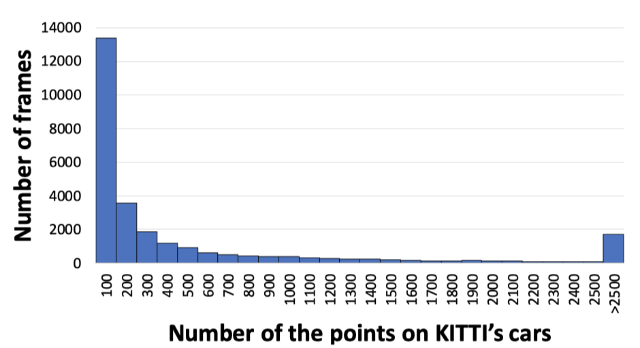
Challenges
Sparsity & disorder

Slide 35
Previous Approaches
Most existing 3D object tracking methods inherit 2D’s experience and rely heavily on RGB-D information.
Rely on 3D template matching, not end-to-end trainable [1]
[1] Silvio Giancola, Jesus Zarzar, and Bernard Ghanem. Leveraging shape completion for 3d siamese tracking. In Proc. IEEE Conference on Computer Vision and Pattern Recognition (CVPR), 2019

Slide 36
P2B Network
Focus on 3D object tracking using only point clouds.
End-to-end trainable with higher efficiency

Slide 37
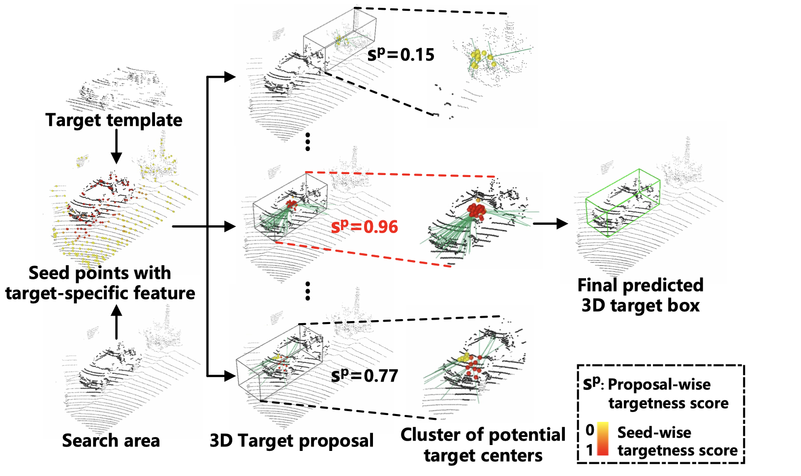
Overview
Augment points in search area to be target-aware
Apply single object detection on the augmented point cloud.

Slide 38
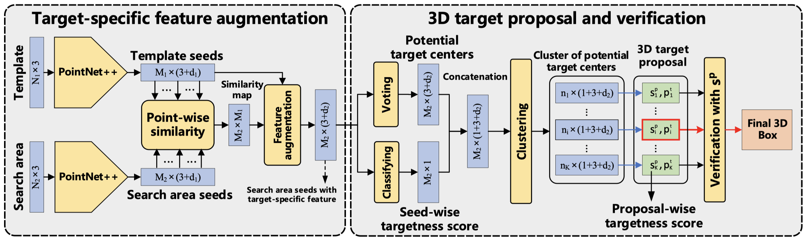
Architecture of P2B
Apply single object detection on the augmented point cloud.
Augment points in search area to be target-aware

Slide 39
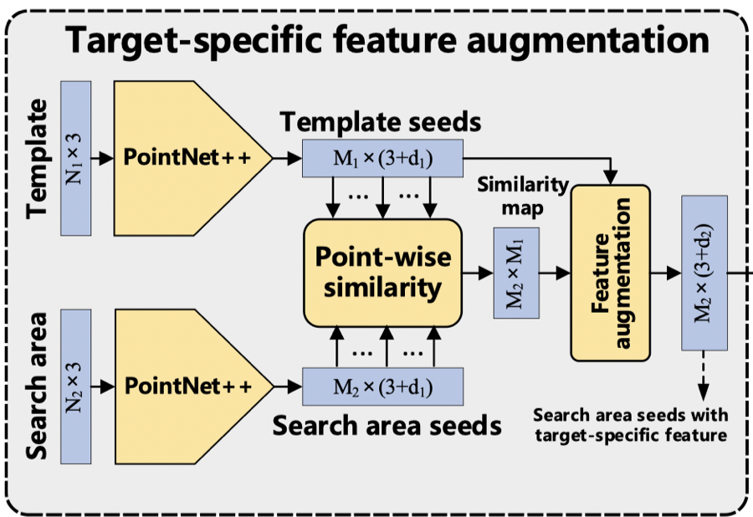
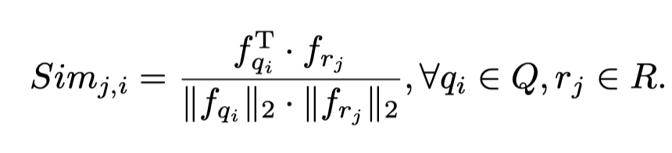
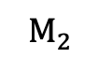
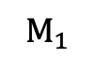
Target-specific feature augmentation
$$M_{1}$$
$$M_{2}$$

Slide 40
Target-specific feature augmentation
$$M_{1}$$
$$M_{2}$$
Not permutation-invariant

Slide 41
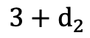
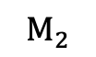
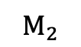
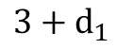
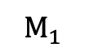
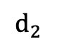
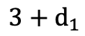
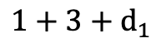
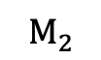


Permutation-invariant target-speciﬁc feature augmentation
$$M_{1}$$
$$3+d_{2}$$
$$1+3+d_{1}$$
PointNet
$$d_{2}$$
$$M_{2}$$
$$M_{1}$$
$$M_{2}$$
permutation-invariant
feature
$$3+d_{1}$$
$$3+d_{1}$$
$$M_{1}$$
$$M_{2}$$

Slide 42




Target proposal & verification
$$3+d_{2}$$
$$M_{2}$$

Slide 43




Ablation Study

Slide 44

Comparison

Slide 45


Comparison

Slide 46
Thanks

